Slide 1
COLT 2024 — OPEN PROBLEM
Can Local Regularization
Learn All Multiclass Problems?
By Mrinal Bharadwaj
Author: Julian Asilis • Siddartha Devic • Shaddin Dughmi • Vatsal Sharan • Shang-Hua Teng
University of Southern California
Proceedings of Machine Learning Research, Vol. 196, 2024

Slide 2





Presentation Outline
01
Motivation
Why study multiclass learning beyond ERM?
02
Related Work
OIGs, DS dimension, and existing learners
03
Proposed Framework
Local regularization as an algorithmic template
04
Experimental Results
ERM failure, local regularizer analysis, scaling
05
Conclusion & Open Problems
What remains to be resolved

Slide 3
01 MOTIVATION
Binary vs. Multiclass Classification
Binary |Y| = 2
Multiclass |Y| >= 2
VC dimension characterizes learnability
ERM is optimal and sufficient
Well-understood since the 1980s
Characterized only in 2022 (DS dimension)
ERM fails — improper learning required
No simple optimal learning rule known
Can we find a simple algorithmic template for multiclass — like ERM for binary?

Slide 4
03 THEORETICAL FORMULAS
The 0-1 Loss and True Risk
Classification Loss & Risk
L_D(h) = E_{(x,y)~D} [ l_{0-1}( h(x), y ) ]
l_{0-1}(y_hat, y) = 0 if y_hat = y, else 1 — the 0-1 loss: wrong prediction costs 1, correct costs 0
D is a distribution over (x, y) pairs — the true data-generating process, unknown to the learner
h : X -> Y is a hypothesis — a function that maps inputs to labels
L_D(h) is the true risk — the expected error of h under the real distribution D
Goal of learning: find h with L_D(h) <= epsilon, i.e., true error at most epsilon

Slide 5
03 THEORETICAL FORMULAS
Empirical Risk & ERM
Empirical Risk Minimization
ERM: output any h in argmin_{h in H} L_S(h)
where L_S(h) = (1/n) SUM_i l_{0-1}( h(x_i), y_i )
S = {(x_1,y_1), ..., (x_n,y_n)} is the training sample drawn i.i.d. from D
L_S(h) is the empirical risk — the fraction of training points h gets wrong
ERM picks any h from H with minimum (ideally zero) training error
For binary classification: ERM is optimal — achieves near-best sample complexity
For multiclass: ERM is PROPER (outputs only h in H) — proven insufficient by Daniely & Shalev-Shwartz (2014)

Slide 6
03 THEORETICAL FORMULAS
PAC Learning (Definition 1)
Definition 1: PAC Learner
For all realizable D, for all eps, delta in (0,1):
P[ L_D(A(S)) <= eps ] >= 1 - delta
when |S| >= m(eps, delta)
A is a PAC learner for H if it can learn to low error with high probability
eps (epsilon) = error tolerance — how much error we allow
delta = failure probability — how often the learner is allowed to fail
m(eps, delta) = sample complexity — how many training points are needed
Realizable: there exists h* in H with L_D(h*) = 0 — perfect hypothesis exists
m_H(eps, delta) = min over all learners A of m_A(eps, delta) — optimal sample complexity of H

Slide 7
03 THEORETICAL FORMULAS
Structural Risk Minimization (SRM)
SRM Learner
SRM: output argmin_{h in H} L_S(h) + psi(h)
where psi : H -> R_{>=0}
psi(h) is a global regularizer — assigns a fixed complexity score to each hypothesis h
SRM balances training error L_S(h) with complexity penalty psi(h)
Problem: SRM is still PROPER — it optimizes over H, so output is always in H
Since improper learning is necessary for multiclass, SRM must fail on some problems
Key limitation: psi(h) assigns ONE complexity value per hypothesis — cannot vary across the domain

Slide 8
03 THEORETICAL FORMULAS
Local Regularization (Definition 2)
Definition 2: Local Regularizer
A(S)(x) in { h(x) : h in argmin_{h in L^{-1}_S(0)} psi(h, x) }
where psi : H x X -> R_{>=0}
psi(h, x) is a LOCAL regularizer — complexity of h can now vary with test point x
L^{-1}_S(0) = { h in H : L_S(h) = 0 } — the set of all hypotheses with zero training error
For each test point x, pick h minimizing psi(h, x) among zero-error hypotheses, then output h(x)
CRUCIAL: output is h(x), not h itself — different test points can use different hypotheses
This enables IMPROPER learning: the combined output 'stitches together' multiple h's across the domain
psi depends on h and x but NOT on the training sample S — this is the key limitation

Slide 9
03 THEORETICAL FORMULAS
H-triangle: Set Construction
Triple Requirements for (A, B, C) in J
|A| = |B| = |C| = k
|A cap B| = |A cap C| = |B cap C| = k/2
A cap B cap C = empty
X = N (natural numbers), Y = {*} U 2^X (star label + all subsets of X)
J = collection of all valid triples (A, B, C) satisfying the three conditions above
Equal sizes: all three sets have the same cardinality k
Pairwise overlap: every pair of sets shares exactly half their elements
Empty triple intersection: no element belongs to all three sets simultaneously
Each triple produces 8 hypotheses (2 choices per pairwise intersection = 2^3)

Slide 10
03 THEORETICAL FORMULAS
H-triangle: Hypothesis Definition
For each (A, B, C) in J, a hypothesis h satisfies:
h(x) = * for x not in A U B U C
h(x) in {A,B} for x in A cap B (constant)
h(x) in {A,C} for x in A cap C (constant)
h(x) in {B,C} for x in B cap C (constant)
Outside all three sets: h defaults to the star label *
On each pairwise intersection: h picks ONE of the two overlapping sets as label — and is constant on the entire region
Geometric intuition: 3 sheets of paper (A, B, C) stacked on overlapping regions; h chooses the stacking order
H-triangle = union of all such hypotheses over all valid triples
H-triangle IS learnable by the Default-Star learner: predict * unless label A containing x was observed

Slide 11
02 RELATED WORK
Multiclass Learning Theory
1984
PAC Learning Framework
Valiant
Foundational learning model — learnability requires low sample complexity.
1989
VC Dimension Characterization
Blumer et al.
Binary classification learnable iff finite VC dimension; ERM suffices.
2014
Improper Learning Necessary
Daniely & Shalev-Shwartz
Proper learners (ERM/SRM) cannot learn all multiclass problems.
2022
DS Dimension Characterization
Brukhim et al.
First characterization of multiclass learnability via the DS dimension.
2024
Local Regularization
Asilis et al.
Introduced local regularizers; unsupervised variant learns all classes.

Slide 12
02 RELATED WORK
One-Inclusion Graphs (OIGs)
Current State-of-the-Art Learners
OIG-based learners use orientations of one-inclusion graphs defined over H, sample S, and test point x
Can be infinite when Y is infinite — existence relies on axiom of choice
Exponentially large even for finite Y, making them impractical
Primarily mathematical — not a practical algorithmic template
Key Distinction
OIG learners use: H + unlabeled data in S + test point x
Local regularizers use: H + test point x (no sample dependence!)

Slide 13
03 PROPOSED METHOD
SRM vs. Local Regularization
Property | SRM: psi(h) | Local Reg: psi(h, x)
Regularizer depends on | h only | h and test point x
Proper or Improper? | Proper only | Can be improper
Learns all binary classes? | Yes | Yes
Learns all multiclass? | No | Open question!
Uses unlabeled data in S? | No | No
Intuition: A local regularizer can assign different complexities to h0 vs h1 depending on the region of X. This per-point flexibility is what enables improper learning.

Slide 14
03 PROPOSED METHOD
Candidate Counterexample: H-triangle
Domain X = N (infinite), Label set Y = {*} U 2^X
Collection J of triples (A, B, C) where |A| = |B| = |C| = k, pairwise intersections k/2, triple intersection empty
Each triple yields 8 hypotheses — one for each way to 'layer' the three sets
h(x) = * outside A U B U C; on pairwise intersections, h is constant choosing between overlapping sets
Geometric Intuition
Think of sheets of paper over regions A, B, C, each bearing their set name. A hypothesis h is a choice of layering order. The output at any point x is the topmost sheet's name visible from above. The class H-triangle is learnable (by the Default-Star learner), but the key question is whether any local regularizer can learn it.

Slide 15
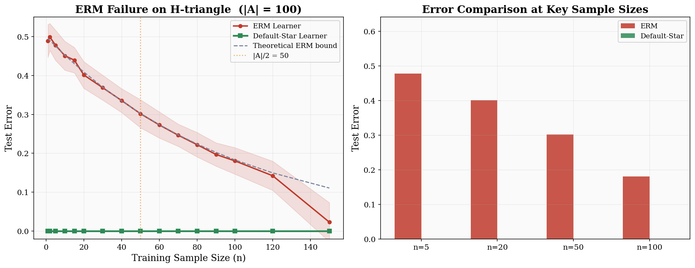
04 EXPERIMENTAL RESULTS
ERM Failure on H-triangle

Slide 16
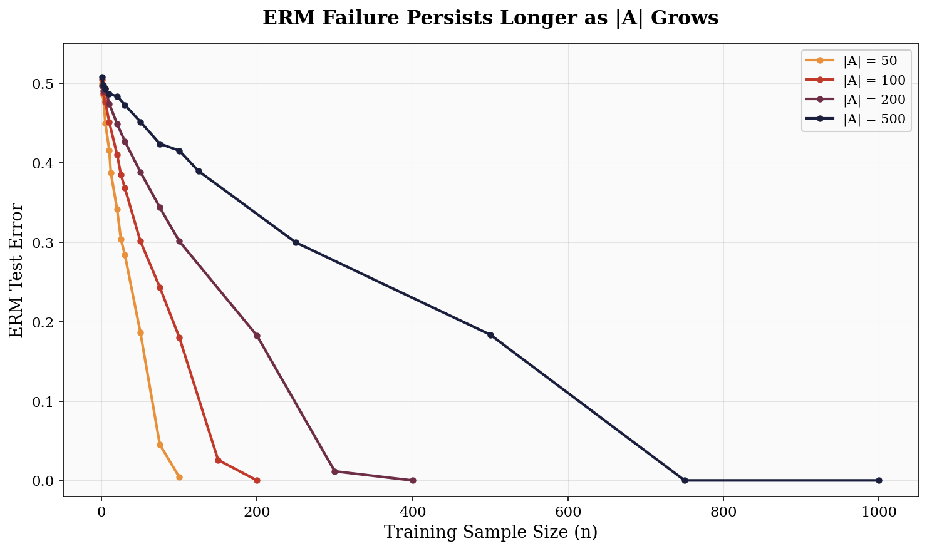
04 EXPERIMENTAL RESULTS
ERM Failure Scales with |A|

Slide 17
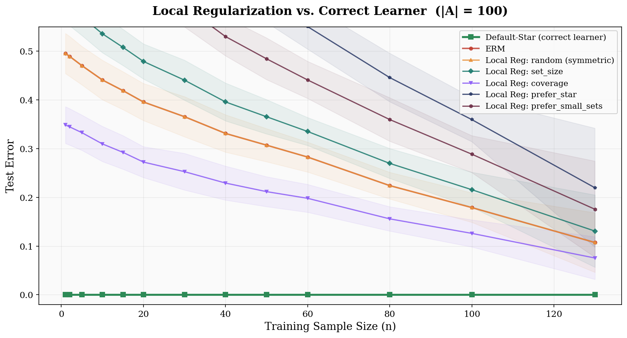
EXPERIMENT 3
Local Regularization Strategies All Fail

Slide 18
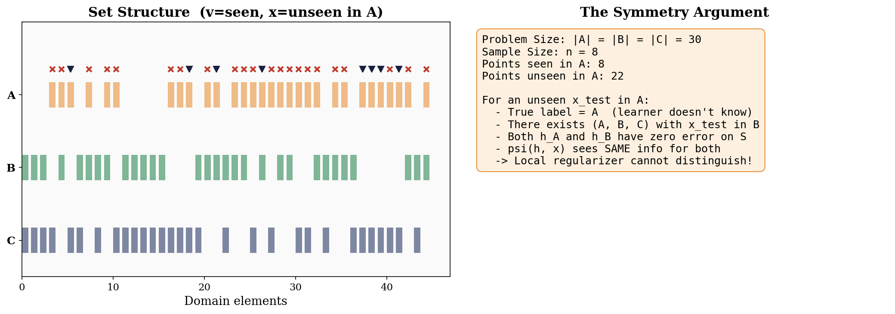
SYMMETRY ARGUMENT
Why Local Regularization Fails

Slide 19
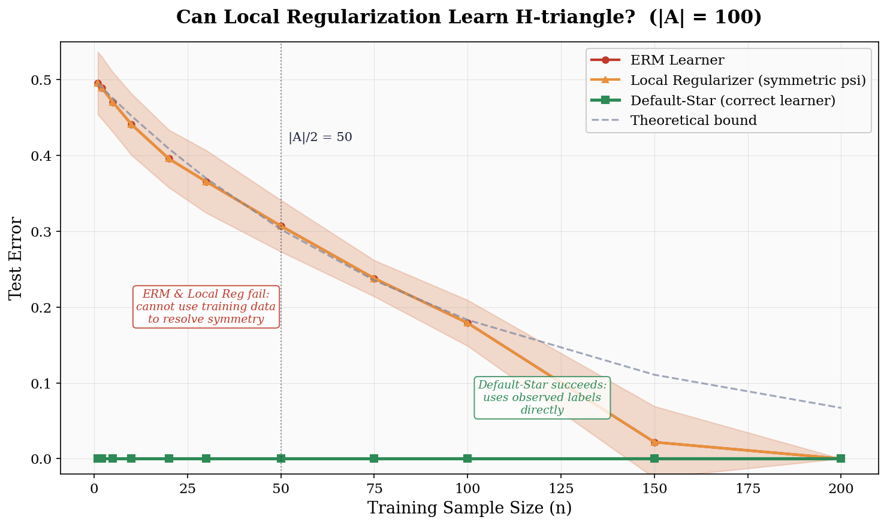
04 EXPERIMENTAL RESULTS
Summary: Can Local Regularization Learn H-triangle?

Slide 20

05 CONCLUSION & FUTURE WORK
Significance of the Open Problems
If Positive
If Negative
Simple, flexible algorithmic template for multiclass learning
OIG structure is vital — vindicates existing body of work
Reveals redundancy of unlabeled data in OIG-based approaches
Training data geometry is essential for learning
Simplifies the theory of multiclass classification
Fundamental limitation on sample-independent methods
Note: Unsupervised local regularization (which can use unlabeled data in S) already learns all multiclass classes with near-optimal complexity.

Slide 21
05 CONCLUSION & FUTURE WORK
Open Problems
Open Problem 1
In multiclass classification, can all learnable hypothesis classes be learned by a local regularizer? If so, with optimal (or nearly optimal) sample complexity?
Open Problem 2
Can the class H-triangle be learned by a local regularizer? If so, with optimal (or nearly optimal) sample complexity?

Slide 22

Key Takeaways
Multiclass classification is qualitatively harder than binary — ERM is insufficient
Local regularization is a promising candidate for a universal multiclass template
The hypothesis class H-triangle is a candidate counterexample leveraging high symmetry
Experiments confirm: ERM and local regularizers fail, Default-Star succeeds

Slide 23
References
[1] Asilis, Devic, Dughmi, Sharan, Teng. Regularization and Optimal Multiclass Learning. COLT 2024.
[2] Brukhim, Carmon, Dinur, Moran, Yehudayoff. A Characterization of Multiclass Learnability. FOCS 2022.
[3] Daniely, Shalev-Shwartz. Optimal Learners for Multiclass Problems. COLT 2014.
[4] David, Moran, Yehudayoff. On Statistical Learning via the Lens of Compression. NeurIPS 2016.
[5] Vapnik, Chervonenkis. On Uniform Convergence. Theory of Prob. & Appl. 1971.
[6] Valiant. A Theory of the Learnable. Comm. ACM 1984.

Slide 24
Thank You
Questions & Discussion
Asilis, Devic, Dughmi, Sharan, Teng
University of Southern California
{asilis, devic, shaddin, vsharan, shanghua}@usc.edu

